Slide 1
C TA 2
casting, typedef, macro, streams, strings

Slide 2
Casting

Slide 3
Primitive Data Types - Casting
Casting - Converting one datatype into another. All primitive types can be cast to each other.
For example, if we want to store an int value into a char we can type cast int to char.
We can do it explicitly by using the cast operator as follows:
int i = 97;
char c = (char) i;
printf("%c", c);
And we can also do it implicitly. Implicit conversions do not require any operator for converted, they are automatically performed when a value is copied to a compatible type in the program. For example:
int i = 97;
char c = i;
printf("%c", c);
i
11000001 | 00000000 | 00000000 | 00000000
a
c
 |  |  | 11000001
a

Slide 4
Primitive Data Types - Casting
Sometimes we cannot perform implicit type casting safely on the data types which are not compatible with each other such as:
Converting float to an int will truncate the fraction part hence losing the meaning of the value.
Converting data type that contains more bytes into data type that requires less (long to int, int to char) cause overflow - dropping of excess high order bits.
int i = 298;
char c = i;
printf("the char is %c and the ascii value is %d", c, c);
the char is * and the ascii value is 42
i
00101010 | 00000001 | 00000000 | 00000000
c
 |  |  | 00101010

Slide 5
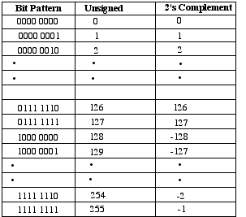
Primitive Data Types - Casting
Another problem can happen when we casting between signed and unsigned types.
For example, the next code will print -128. Why?
unsigned char d = 128;
signed char c = d;
printf("%d", c);
128 is represented in binary as when read it into signed char, the first bit
(most significant) indicates whether the number is negative
(1) or positive (0). So, if we try to put 128 in a char,
it’s value will be -128.
1 | 0 | 0 | 0 | 0 | 0 | 0 | 0

Slide 6
Primitive Data Types – Casting Rules
The following rules have to be followed while converting the expression from one type to another to avoid the loss of information:
All integer types to be converted to float.
All float types to be converted to double.
All character types to be converted to integer.

Slide 7
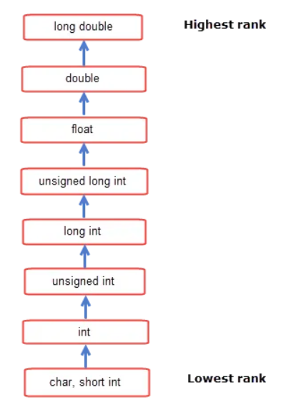
Casting in Expressions
Whenever two operands of different data types are involved in an expression, the operand of lower rank will be converted to a data type of higher rank.
int i = 10;
char a = 'a';
int res = i + a; // a will be converted to int // before addition

Slide 8
Casting – More Examples
float a = 1.0;
int b = a + 12;
printf("b = %d", b);
b = 13
c is converted to int,
then the result of d + c (which is of type int)
is converted to float
int d = 17;
char c = 'c'; // ascii value of c is 99
float sum = d + c;
printf("sum = %.2f", b);
sum = 116.00
int i = 500;
char c = i;
int j = c;
printf("j = %d", j);
The conversion of i to char causes a lost of information, so when converting c to integer we actually convert a different binary sequence
j = -12

Slide 9
Typedef

Slide 10
typedef
typedef lets you define new names for existing data types – makes your program more readable and easier to write.
typedef can be used both for built in datatypes and user defined data types (structs)
typedef unsigned long size_t;
typedef struct Complex Complex; //one way typedef struct Complex { int _img; int _real; } Complex;//second way

Slide 11
typedef
typedef lets you define new names for existing data types – makes your program more readable and easier to write.
typedef can be used both for built in datatypes and user defined data types (structs)
typedef unsigned long size_t;
int main() { int p;
unsigned long sizeOfInt1 = sizeof(p); size_t sizeOfInt2 = sizeof(p); return 0; }

Slide 12
typedef
typedef lets you define new names for existing data types – makes your program more readable and easier to write.
typedef can be used both for built in datatypes and user defined data types (structs)
int main() { struct Complex COMPLEX = {1,2}; Complex COMPLEX2 = {1,4}; return 0; }
typedef struct Complex Complex; typedef struct Complex { int _img; int _real; } Complex;//second way

Slide 13
Macro

Slide 14
Macro
There are 3 stages C code goes through before it can be run on a computer:
Preprocessing – replace macros, remove comments, remove empty lines, etc…
Compilation – turn C code into machine readable code
Linkage – link between usage of function/variable and the implementation
We declare a macro with the #define directive
We can use macros to define constants (magic strings and numbers, etc.), like in the above example
A macro can get parameters
This is a textual replacement – that can lead to unwanted behavior if not done properly!
#define E 2.71828
#define ADD(x,y) x+y #define POW(x) x*x
Notes:
Don’t go into what really happens in each step – tell them we’ll learn more on that later in the course
Not important, but if the ask – they can use \ to define a multiline macro

Slide 15
Macro – unwanted behavior
#define POW(x) x*x #define ADD5(x) x+5 #define SUB5(x) x-5 int main() { int a = 4; int b = a * ADD5(a); int c = a * SUB5(a); int d = POW(a-1)*POW(a+1); printf("%d, %d, %d", b, c, d); return 0; }
What will be printed?
36, -4, 225
21, 11, 1
36, -4, 1
21, 11, 225
Notes:
Note that there is code hidden under the visible code -
Animation adds the parenthesis after the poll

Slide 16
Macro – unwanted behavior
#define POW(x) x*x #define ADD5(x) x+5 #define SUB5(x) x-5 int main() { int a = 4; int b = a * ADD5(a); int c = a * SUB5(a); int d = POW(a-1)*POW(a+1); printf("%d, %d, %d", b, c, d); return 0; }
What will be printed?
36, -4, 225
21, 11, 1
36, -4, 1
21, 11, 225
#define POW(x) x*x #define ADD5(x) x+5 #define SUB5(x) x-5 int main() { int a = 4; int b = a * a + 5; int c = a * a - 5; int d = a – 1 * a – 1 * a + 1 * a + 1 ; printf("%d, %d, %d", b, c, d); return 0; }
Notes:
Note that there is code hidden under the visible code -
Animation adds the parenthesis after the poll

Slide 17
Macro – unwanted behavior
#define POW(x) ((x)*(x)) #define ADD5(x) ((x)+5) #define SUB5(x) ((x)-5) int main() { int a = 4; int b = a * ((a)+5); int c = a * ((a)-5); int d = ((a-1)*(a-1))*((a+1)*(a+1)); printf("%d, %d, %d", b, c, d); return 0; }
What will be printed?
36, -4, 225
21, 11, 1
36, -4, 1
21, 11, 225
#define POW(x) x*x #define ADD5(x) x+5 #define SUB5(x) x-5 int main() { int a = 4; int b = a * ADD5(a); int c = a * SUB5(a); int d = POW(a-1)*POW(a+1); printf("%d, %d, %d", b, c, d); return 0; }
#define POW(x) ((x)*(x)) #define ADD5(x) ((x)+5) #define SUB5(x) ((x)-5) int main() { int a = 4; int b = a * ADD5(a); int c = a * SUB5(a); int d = POW(a-1)*POW(a+1); printf("%d, %d, %d", b, c, d); return 0; }
Notes:
Note that there is code hidden under the visible code -
Animation adds the parenthesis after the poll

Slide 18
Macro - examples
Header files usually contain their own macros which we can use, such as
EOF – defined in stdio.h,
true – defined in stdbool.h,
false – defined in stdbool.h,
EXIT_SUCCESS – defined in stdlib.h,
EXIT_FAILURE - defined in stdlib.h,
#define EOF (-1)
#define true 1
#define false 0
#define EXIT_SUCCESS 0
#define EXIT_FAILURE 1

Slide 19
streams

Slide 20


What it is a stream?
A stream is a flow of data from a source (keyboard, files) or to a destination (screen, files).
keyboard
stdin
The program
0 1 0 1 0 1 0 1 0 1 0 0 0 1 1 0 0 1 1 0 1 0 0 0
screen
stdout
0 0 1 0 1 1 1 0 1 0 0 1 1 1 0 1 0 1 0 1 0 0 0

Slide 21
Input
Similar to the standard output (stdout) which is the screen, there is also the standard input (stdin), which is the keyboard.
In C, we have an indication for reaching the end of the input – EOF, which stands for End Of File
EOF is not a variable, type or similar – again, it’s a macro.
EOF is returned when we try to read from an input source (such as stdin), but there is nothing more to read.
We can read character by character, or in a formatted manner, using:
getchar()
fgets()
sscanf()

Slide 22
getchar() and putchar()
getchar() reads one character from stdin and “deletes” from stdin (not really deleted – the file pointer is advanced, but more on that later in the course)
The function returns the character read as an unsigned char cast to an int or EOF on end of file or error
putchar(char) writes one character to stdout.
Can you guess what the following program does?
#include <stdio.h> int main() { int c; while ((c = getchar()) != EOF) { putchar(c); } return 0; }

Slide 23
fgets()
Reads characters from stream and stores them as a C string until a specified number of characters have been read or either a newline or the EOF is reached, whichever happens first.
A newline character makes fgets stop reading, but it is considered a valid character by the function and included in the string copied to str.
A terminating null character is automatically appended after the characters copied to the string.

Slide 24
fgets()
The parameters of the function are:
1. Array of chars where the string read is copied.
2. Maximum number of characters to be copied into the string (including the terminating null-
character).
3. The stream from which the input is read (stdin, files).
#include <stdio.h>
int main()
{
char str[10];
fgets(str, 10, stdin);
printf("%s", str);
return 0;
}
Input: Hello World
Output: Hello Wor
Notes:
The function returns the string in success, if not a pointer to NULL

Slide 25
fgets() and sscanf()
If we want to parse the string we read into variables we can use sscanf.
The function reads a formatted input from a string.
On success, the function returns the number of variables filled. In the case of an input failure before any data could be successfully read, EOF is returned.
Another option for parsing – strtol (google it)
int main()
{
char str[8];
int age;
float height;
printf("Please enter your age and your height\n");
fgets(str, 8, stdin);
sscanf(str, "%d %f", &age, &height);
printf("Age: %d, Height: %.2f", age, height);
return 0;
}

Slide 26
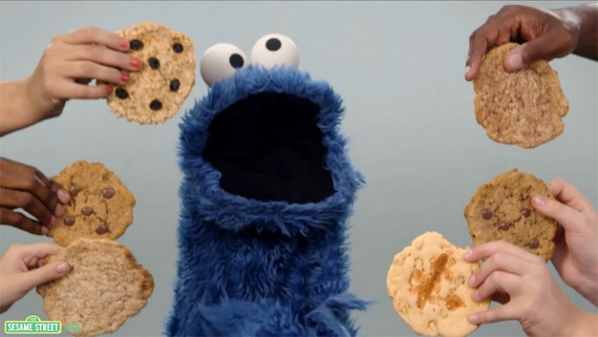
stderr
stderr is the standard error stream, where the program can write error messages. Like stdout, it is directed to the screen. So what is the difference between the two streams? First, lets talk about buffer.
Consider a case when you have a bakery, where you bake cookies to feed Cookie Monster in them.
Every cookie that is baked, it is transferred immediately to the monster who’s waiting in his house. The cookies are baked very fast, but it takes some time to bring them to the monster.
You need to find a way to store the cookies, so you can deliever them efficiently and Cookie Monster will eat them at ease.

Slide 27
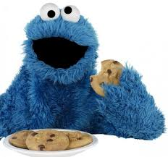
Buffered Stream
The solution is – put the cookies on a box, so every time when the box is full, we it will be delivered to Cookie Monster.
In our world, the cookies are the data we want to output, and we want sometimes to store it in a buffer before transmitting it.
stdout is a buffered stream - any output written to the stream is stored in a buffer.
This means that when we print a message to stdout, it will not be printed immediately. First, It will be stored in the buffer. When possible, the data is flushed, and the message will be printed.

Slide 28
stderr
Now consider the next scenario – the oven broke down, and we have to announced Cookie Monster about it so he can order cookies from another bakery (he’s very hungry and can’t wait). We have to send him the message immediately!
Back to C, in contrast to stdout, the stderr is unbuffered, which means that any message written to the stderr will be printed immediately.
text written to standard error later may appear on the terminal earlier, if the standard output stream buffer is not yet full.
The advantage of this is that you can react to errors as they occur.
Notes:
Another advantages of having stderr - we can redirect a command’s output (stdout) to a file and still see any error messages (stderr) in the terminal window. It stops the error messages from contaminating the file that stdout has been redirected into.

Slide 29
strings

Slide 30
Strings in C
In C, strings are a sequence of characters.
As such, they can be declared in one of two ways – using arrays or using pointers. For now, we will learn using strings defined as char arrays.
In order to know where a string ends, the null character “\0” should be inserted after the last character.
char txt1[5]; //uninitialized - we don't know what
// values are present in each cell txt1[0] = 't'; //and so forth char txt2[5] = "text"; // \0 is implicitly added char txt3[5] = {'t','e','x','t','\0'}; // \0 needs to be added explicitly

Slide 31
Strings in C
We can treat strings in the same way we treat arrays.
int i = 0;
while (str[i] != '\0')
{
str[i] = '*';
}
printf("%s", str);
0x00
0x01
0x02
0x03
0x04
0x05
0x00
0x06
H
E
L
L
O
\0
B
E
L
L
O
\0
*
*
*
*
*
\0
char str[] = "HELLO";
printf("%c", str[0]);
str[0] = 'B';
printf("%s", str);
H
BELLO
*****

Slide 32
Strings in C
When a string is represented as an array, we can’t do as follows:
char str[] = "my string";
str = "some string"; // compilation error
char str1[] = "some string";
str = str1; // compilation error

